Slide 1
Bangladeshi Road Sign Detection Using Deep Learning Technique for Driver Assistance System
Presented by
Ashraful Reza Tanjil
2019-1-60-221
Fahim Md. Adud Bhuiyan
2019-1-60-223
Md. Ashraful Hasan
2019-1-60-219
Sherajum Monira Noha
2019-1-60-228
Supervisor: Musharrat Khan
Senior Lecturer
Department of Computer Science and Engineering
East West University

Slide 2
Table of Contents
06
01
Introduction
Result & Discussion
02
Research Question
07
Conclusion
03
Research Objectives
08
Appendix
04
Related Works
05
Materials & Method

Slide 3
Introduction
Road sign detection using deep learning techniques is a field of study that uses machine learning algorithms to detect and recognize road signs.
The goal of road sign detection is to improve road safety and make the driving experience more convenient for drivers.
With the advent of deep learning techniques, specifically convolutional neural networks, researchers were able to create more sophisticated algorithms that could accurately detect and recognize a wider variety of objects in images.

Slide 4
Introduction (Contd.)
Nowadays, road sign detection using deep learning techniques is a key component of many driver assistance systems, such as autonomous vehicles and advanced driver assistance systems (ADAS).
These systems use a combination of cameras, sensors, and algorithms to detect and interpret road signs in real time, providing drivers with relevant information and improving road safety.

Slide 5
Introduction(Contd.)
Our capstone project set out to find better ways of spotting road signs in the traffic-challenged nation of Bangladesh. Using the VGG-16 model and a number of image processing methods, it tested how well detectors worked in a wide range of environmental and illuminant contexts. The research also evaluated the efficiency of various traffic sign kinds and looked at the possibility of connection with driver assistance technologies. There was a comparison of the accuracy of several pre-trained models, including GoogLeNet (97.60%), ResNet-50 (98.33%), AlexNet (84.01%), and VGG-16 (99.52%). For excellent road sign detection, VGG-16 has emerged as the most promising algorithm, potentially enhancing road safety and traffic management.

Slide 6

Research Question
Can the system detect road signs from a sufficient distance?
How can road sign detection be integrated with other driver assistance systems to improve overall system performance and road safety?
Does the performance of the model change with different weather and lighting conditions?
How well does the proposed method perform on different types of traffic signs and under different lighting conditions?

Slide 7
Research Objectives
Dataset Creation
Pre-processing
We created a dataset by taking pictures of different road signs
We converted these images from RGB to Grayscale to simplify the data.
Model Training
App Development
Based on test results, select the best-performing model and develop an application that provides both Bangla text and audio alerts explaining detected road signs.
We trained different pre-trained CNN models using the training data set.

Slide 8
Related Works
1
2
3
Real-Time Traffic Sign Recognition Using YOLOv3 based Detector by S. P. Rajendran, L. Shine, R. Pradeep , S. Vijayaraghavan.
Indian traffic sign detection and recognition using deep learning by R. K. Megalingam, K. Thanigundala, S. R. Musani, H. Nidamanuru, and L. Gadde.
Traffic-Sign Recognition For An Intelligent Vehicle/Driver Assistant System Using HOG by K. Pl, M.Roomi.
The authors of [1] provide a new deep learning-based traffic sign recognition method in India. In this paper, a viable deep-learning approach for the detection and recognition of Indian road traffic signs was developed. The proposed approach performed well under a variety of situations, including changes in scale, orientation, and illumination. The research introduces RMR-CNN, a modified version of Mask R-CNN with enhancements to its architecture, data augmentation, and parametric value refining. The suggested method extracts features from photos of Indian traffic signs using a deep convolutional neural network (CNN). The photos are first resized and normalized by the authors before being used to extract features using CNN. The recognition of traffic signs is subsequently done using the retrieved features. The authors test their methodology using the Indian Traffic Sign Dataset (ITSD) and demonstrate that it performs better than other cutting-edge techniques for identifying Indian traffic signs. High accuracy and a low false alarm rate have been attained. The research provides a new methodology for Indian traffic sign recognition utilizing deep learning techniques, specifically a deep convolutional neural network (CNN). Precision, recall, and F measures for all three models are for Fast RCNN 93%, 94%, 93.4% Mask R CNN 94.4%, 96.7%, 95.53%. RMR-CNN 97.08%, 96.75%, 96.87%.
The work in [2] is on an intelligent transport system. The project works with different traffic sign conditions. There are 4 kinds of signs. Warning Signs, Compulsory Signs, Regular signs, and Informatory signs. The proposed approach of the project was first to train the data set and then work with the testing stage. At the training stage, the RCB color-based threshold will help to analyze the shape and then extract the features. These features will be saved in the database. From this classification of traffic signs will be done and test data will be categorized at that classification and a better result will be found. Normalized RGB color space is used for RGB-Based color thresholding. Shape Analysis is used in this project to clean the binary image from noise and small objects and apply connected components labeling algorithms to identify the traffic sign. This project uses HOG (Histogram of Oriented Gradients) to recognize pedestrians. KNN (K-Nearest Neighbor) algorithm is used to find the closest object sets similar to each other. r. The proposed project for traffic sign recognition attains a classification accuracy of 63%
The paper of [3] proposed a traffic recognition system based on a CNN-based classifier and a YOLOv3-based detector. For the detector and classifier's training and evaluation, a PC equipped with an Nvidia GTX 1060 GPU and 6GB GPU RAM was employed. GTSDB and GTSRB databases were tested by the authors. The GTSRB dataset consists of more than 50000 traffic sign images of 43 classes with sizes ranging from 15×15 pixels to 222×193 pixels. The GTSDB dataset consists of 600 training images and 300 test images of 1360×800 pixels from urban, rural, and highway locations under various weather and lighting conditions. Positive detection is defined as Intersection over Union (IoU) > 0.5 between the ground truth box and the predicted bounding box. Utilizing the GTSDB test set, the detector's performance is compared against an R-CNN traffic sign detector implementation. On the GTSDB test set, the suggested YOLOv3-based detector demonstrated great accuracy with a mAP of 92.2% and a frame rate performance of almost 10 frames per second. The GTSRB test set, which contains 12630 photos, was used to evaluate the CNN-based customs traffic sign classifier. A model trained without the addition of new data might attain a 96.46% accuracy. Accuracy has increased with data augmentation to 99.6% .

Slide 9
Related Works
6
Recognition of Traffic Signs with Artificial Neural Networks: A Novel Dataset and Algorithm by A. Kerim and M. O. Efe.
4
5
Traffic Sign Recognition with a small convolutional neural network by W. Li, D. Li, and S. Zeng.
Real-Time traffic sign recognition based on efficient CNNS in the wild by B. Venkatesu and S. F. Anwar.
The project [6] describes a novel dataset and algorithm for recognizing traffic signs using artificial neural networks. The authors collected a dataset of traffic sign images and used it to train and evaluate an artificial neural network for the task of traffic sign recognition. In this paper, they were starting their methodology by combining data sets GTSRB and TSRD by merging those data sets together. After merging two datasets they were, we resized all of the cropped images to 32 x 32 pixels for preprocessing TSRD and GTSRB and they inspected all the 101 classes of the new dataset manually. They followed the rule of thumb by taking 80% for training, 10% for validation, and 10% for testing. Thirdly they did data augmentation by increasing the number of observations. For data augmentation, they have been done such as translation, rotation, noising, color, intensity jittering, and blurring. Following the application of the aforementioned data augmentation strategies. Feature extraction from images used a novel classification algorithm. In their paper, they used Hybrid-ANN Classification Models for their data set. As they had many predictions that’s why they used Hybrid-ANN Decision Model. In their proposal, we performed two sets of experiments to further validate our results such as experiments on the GTSRB dataset and experiments on the Dataset Created. The HOG feature extraction algorithm with a cell size of 4 x 4 obtained the best accuracy of around 80% and for experiment -2 their novel dataset achieved an 87% top-1 classification accuracy while a 95% was obtained for top-2 classification accuracy.
The project [4] used an Artificial Neural Network algorithm to recognize traffic signs which they called the CNN module. This study proposes a CNN TS-Module module for traffic sign recognition. Several trials on the traffic signs dataset show that the module's CNN is more suited for traffic sign identification than the classic CNN, because the typical convolution is done through a single layer. The 3*3 convolution kernel conducts feature extraction, which has the problem of producing an excessive number of parameters. The gradient diminishes as the network deepens, resulting in poor network performance. The TS-Module module CNN employs many sets of convolutions in its implementation. A 3*3 convolution kernel is created by connecting a 1*3 convolution kernel and a 3*1 convolution kernel via a 1*1 convolution kernel. The experience field effectively deepens and broadens the network, while multi-channel convolution can not only extract a variety of information but also considerably lower the parameters, increasing the network's practicality. CNN also mentions the residuals. This module is 87% or more accurate than the GTSRB data set.
The paper [5] presents a method for recognizing traffic signs in real time using efficient convolutional neural networks (CNNs). The authors propose a new CNN architecture that is optimized for real-time traffic sign recognition, as well as a new dataset for training and testing the CNNs. The authors proposed Faster R-CNN and MobileNets are combined and modified to make the detection process more efficient. A pretty good detection result of unique traffic signs is reported for the first time on the GTSDB database. An easy approach based on color and shape information for the localization refinement of small traffic signs is proposed, improving the detection quality and the classification accuracy of typical traffic signs. The traffic Sign Recognition (TSR) method used computer vision and machine learning methods. For the recognition of traffic signs, the benchmark dataset GTSRB. In Network Architecture they have used CNN architectures such as CNNs, VGGNets, ResNets, DenseNets, and LeNet-5. For Network Regularisation they have been used data argumentation, dropout, parameter norm penalty, and early stopping have. Then they optimize the network by using the training of CNNs, the training of CNNs, etc. Their proposed system has traffic sign detection (Faster R-CNN), base convolutional layers, Region Proposal Network (RPN), RoI Pooling Layer, Classifier, and Loss Functions. Convolutional neural networks have achieved state-of-the-art traffic sign classification.

Slide 10
Related Works
9
Road Sign Detection and Translation in Bangla Using Image Processing and Machine Learning by K. A. Mubin, N. F. Zaman, Saima, Islam.
7
8
Traffic Sign Recognition and Classification Using YOLOv2, Faster RCNN and SSD by P.Garg, D. R. Chowdhury. V. N. More
Traffic sign recognition with convolutional neural network based on max pooling positions by R. Qian,Y. Yue, F. Coenen, B. Zhang
A method for recognizing and classifying traffic signals is developed in the paper [7] using You Only Look Once (YOLOv2), Faster Region Convolutional Neural Network (RCNN), and Single Shot Detector (SSD). The authors constructed these three designs in the TensorFlow environment using the Anaconda 5.1.0 Windows platform and measured the performance using the mAP (mean average precision) and FPS (frames per second) benchmarks. The effectiveness of object detectors and classifiers is assessed using mAP. The German Traffic Sign dataset, which contains several traffic signs with distortions such as sunshine reflections, wind effects, barricades, and occlusions, was used to evaluate their methods. In this methodology, 530 photos are utilized as the verification objective while 7832 images are used to train SSD, faster RCNN, and YOLOv2. These pictures were categorized by the authors into five categories: pedestrian crossing, no entrance, speed restriction, stop sign, and turn ahead. Using their mAP and FPS, SSD, Faster RCNN, and YOLOv2 are contrasted and evaluated. Their overall average mAP’s are 68.35, 74.68, and 77.89 for the five classes. In terms of overall accuracy performances, YOLOv2 is faster and more accurate than both Faster RCNN and SSD, but SSD is less accurate than Faster RCNN and SSD.
A method for recognizing traffic signals is developed in the paper [8] using a convolutional neural network (CNN) and the "max pooling" technique. The authors propose a model approach to distinguishing traffic signs that combines the color and shape of the traffic signs. The suggested technique employs a CNN with a max pooling layer to extract features from the color and shape. In contrast to earlier techniques, which often used CNN as a feature extractor and multilayer perceptron (MLP) as a classifier, they proposed max pooling positions (MPPs) as a potent discriminative feature to predict category labels. The desirable traits of little inter-class variance and big intra-class variance are demonstrated by MPPs through extensive studies. Utilizing the max pooling layer, the most important characteristics from the CNN are selected, and the features are then used to recognize traffic signs. The German Traffic Sign Recognition Benchmark (GTSRB) dataset is used by the authors to compare their suggested strategy against a number of state-of-the-art methods for traffic sign recognition and show that it outperforms them. Their accuracy rate is 98.86%.
The authors propose a system that uses a combination of image processing and machine learning techniques to detect and translate road signs in the Bengali language in real-time the paper [9]. The authors use several image-processing techniques for road sign detection, such as color-based thresholding, morphological operations, and edge detection. These techniques are used to extract the region of the image that contains the road sign and to remove any unnecessary background information. For road sign recognition, the authors use a convolutional neural network (CNN), a type of deep learning algorithm commonly used for image classification tasks. The CNN is trained on a dataset of road sign images and their corresponding labels. The authors use a machine translation model for road sign translation to translate the recognized text from English to Bengali. Machine translation models use neural networks to learn the relationship between two languages and generate translations

Slide 11
Related Works
10
11
Traffic Sign Detection and Recognition Model Using Support Vector Machine and Histogram of Oriented Gradient by N. Ahmed, S. Rabbi, T. Rahman, R. Mia, and M. Rahman
Bangladeshi Road Sign Recognition Based on DtBs Vector and Artificial Neural Network by S. Chakraborty, M. N. Uddin, and K. Deb
The paper [10] presents a model for detecting and recognizing traffic signs using a combination of Support Vector Machine (SVM) and Histogram of Oriented Gradient (HOG) feature descriptors. Pictures of traffic signs collected from streets of Bangladesh are categorized based on the type of traffic sign and stored on a data set. This data set will be used to train the classifier model. SVM(support vector machine) will be made using the OpenCV library of python, it will classify the data using the HOG (Histogram of Oriented Gradients)property. If the result is 96% correct it will be taken into consideration. Their Proposed Approach is the Identification of the traffic sign by playing a video and extracting frames. Match them with pre-processed frames, Generation of SVM Classifier Model using Hog, Detection, and recognition of traffic signs from video Input, After all of those have been done detection and recognition of traffic Signs from video input by using Similarity Measurement algorithm. For implementation, they used a dataset of Bangladeshi traffic signs with 1000 images of 6 different classes, each class containing approximately 170 images to train the model. The project was implemented with the help of JetBrains PyCharm, OpenCV, and Numpy. The final results were a precision of 100%, recall of 95.83%, and accuracy of 96.15%.
The project [11] converts images from RGB to the YCbCr color model to extract candidate regions and avoid the illumination sensitivity of color. The second part allows procedures for detecting ROI by using color segmentation in YCbCr color space. In YCbCr color space, any color is represented by the values of its intensity. Noises are eliminated using a morphological closing operation to recover the gaps smaller than 5 consecutive pixels. Eight connected components concept is used for labeling. After that geometrical features such as the area and aspect ratio of each region are extracted. Distance to Borders (DtBs) vector is a robust method for rotated and scaled objects to recognize the shape. To calculate the DtBs we have calculated the Euclidean distance between the bounding box (BB) and perimeter position of the RSs. A BB has 4 sides so the DtBs will generate 4 vectors. For every time the vector is calculated. The detected RS will be resized as 30X30 blobs that represent 900 pixels by ANN (Artificial Neural Network). These will be normalized into 60 outputs by averaging each column and row intensity values. Then these 60 values feed into the neural network. To recognize the content of road signs, ANN is used with three layers. The first layer consists of 60 inputs as the input layer. So, there are 3 layers Input, Output, and Hidden layer. The frame size of the image is resized as 448X336 pixels. Celeron Dual Core CPU 2.10GHz processor computer with 4GB ram has been used to execute the program to classify the BRS. The program has been developed under the MATLAB environment. Considering the above conditions, the successful road sign detection and recognition rate is about 94.87% and 92.79%.

Slide 12
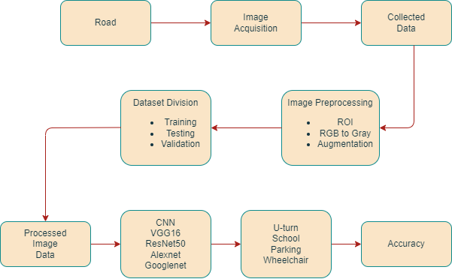
Materials & Methods
Proposed Methodology
Our project was done step by step following a pipeline, which can be described as our proposed methodology.

Slide 13
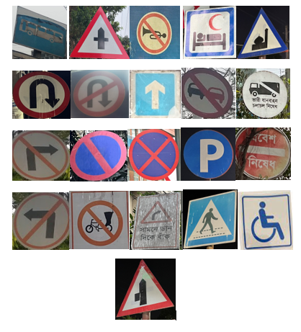
Data Collection
We Took 21 different traffic signs for our dataset.

Slide 14
Data Sampling
The dataset has been sampled into three sections, which are train, test, and validation. A simple random sampling has been used to split the dataset. For gathering data, this technique is much more reliable than any others. From the dataset 70% of the images in the training set, 20% in the testing set, and 10% in the validation set.

Slide 15
Data Processing
Selecting region of interest (ROI).
For data processing, first, we converted our dataset to grayscale.
Then, we resize all photos to the same 600X600-pixel size.
After that, we used data augmentation to increase our dataset from 525 to 8400 images.

Slide 16
Implemented Models
GoogLeNet
RestNet50
AlexNet
VGG16

Slide 17
Result Analysis
Here is a table showing the accuracy
Model | Accuracy
GoogLeNet | 97.60%
ResNet-50 | 98.33%
AlexNet | 84.01%
VGG-16 | 99.52%

Slide 18
In evaluating driver assistance systems for road sign identification in Bangladesh, accuracy is crucial, but not the sole factor. Accuracy of 97.60% is reached by GoogLeNet thanks to its efficient feature acquisition. ResNet-50's success at 98.33% can be attributed to its depth and skip connections. At 84.01%, AlexNet is promising. VGG-16 is the most accurate model at 99.52%. The state of the art in road sign detection is currently being led by the networks ResNet-50 and VGG-16.
Discussion

Slide 19
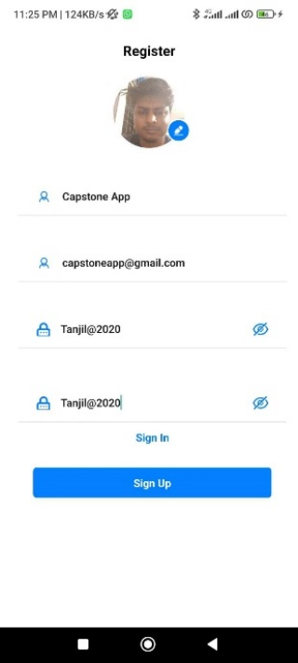
Demo of our APP
Sign In

Slide 20
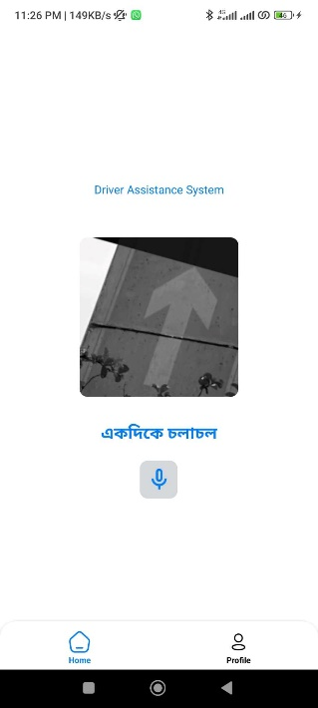
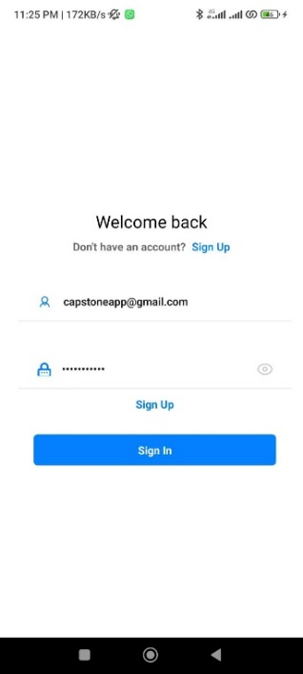
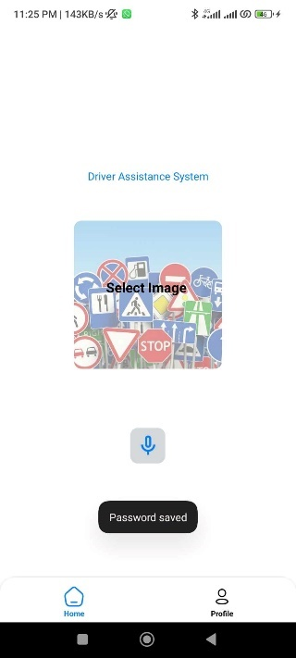
Sign UP
App Home
Sign Detection

Slide 21

Mobile App Development cost
Approximate Cost will be 25000 BDT.

Slide 22




Materials & Devices
We have used most popular modern technologies and tools to make our prediction models and frontend backend system for the project.
React Js
Django
React Js
Django
VS Code
Python

Slide 23
Conclusion
The Bangladeshi Road Sign Detection System, Using Deep Learning Techniques for Driver Assistance Systems, and incorporating VGG-16 for real-time detection, can improve environmental and socioeconomic issues by lowering accidents, traffic violations, and pollution. It detects numerous traffic signs in real time and provides Bangla voice help. Future work will involve increasing the dataset and developing a live video traffic sign identification software to solve these constraints and promote safer driving.

Slide 24
References
[1] R. K. Megalingam, K. Thanigundala, S. R. Musani, H. Nidamanuru, and L. Gadde, “Indian traffic sign detection and recognition using deep learning,” International Journal of Transportation Science and Technology, 2022, 26 June 2022, doi: 10.1016/j.ijtst.2022.06.002.
[2] K. Pl, M. Roomi, “Traffic-Sign Recognition For An Intelligent Vehicle/Driver Assistant System Using HOG,” Computer Science & Engineering: An International Journal, vol. 6, no. 1, pp. 15–23, Feb. 2016, doi: 10.5121/cseij.2016.6102.
[3] S. P. Rajendran, L. Shine, R. Pradeep, S. Vijayaraghayan. “Real-Time Traffic Sign Recognition Using YOLOv3 based Detector,” 10th International Conference on Computing Communication and Networking Technologies (ICCCNT), 06-08 July 2019, doi: 0.1109/ICCCNT/45670.2019.8494890
[4] W. Li, D. Li, and S. Zeng, “Traffic Sign Recognition with a small convolutional neural network,” in IOP Conference Series: Materials Science and Engineering, Dec. 2019, vol. 688, no. 4. doi: 10.1088/1757-899X/688/4/044034

Slide 25
References
[5] B. Venkatesu and S. F. Anwar, “Real-Time traffic sign recognition based on efficient CNNS in the wild,” IEEE Transactions on Intelligent Transportation Systems, Volume: 20, Issue: 3, March 2019 doi: 10.1109/TITS.2018.2843815.
[6] A. Kerim and M. O. Efe, “Recognition of Traffic Signs with Artificial Neural Networks: A Novel Dataset and Algorithm,” in 3rd International Conference on Artificial Intelligence in Information and Communication, ICAIIC 2021, Apr. 2021, pp. 171–176. doi: 10.1109/ICAIIC51459.2021.9415238.
[7] P. Garg, D. R. Chowdhury, V. N. More, “Traffic Sign Recognition and Classification Using YOLOv2, Faster RCNN and SSD,” 2019 10th International Conference on Computing, Communication and Networking Technologies (ICCCNT), 06-08 July 2019, doi: 101109/ICCCNT45670.2019.8944491.
[8] R. Qian, Y. Yue, F. Coenen, B. Zhang, “Traffic sign recognition with convolutional neural network based on max pooling positions,” 2016 12th International Conference on Natural Computation, Fuzzy Systems and Knowledge Discivery (ICNC-FSKD), 13-15 August 2016, doi:10.1109/FSKD.2016.7603237.

Slide 26
References
[9] K. A. Mubin, N. F. Zaman, S. Islam, “Road Sign Detection and Translation in Bangla Using Image Processing and Machine Learning,” Thesis report, BRAC University,2019.
[10] N. Ahmed, S. Rabbi, T. Rahman, R. Mia, and M. Rahman, “Traffic Sign Detection and Recognition Model Using Support Vector Machine and Histogram of Oriented Gradient,” International Journal of Information Technology and Computer Science, vol. 13, no. 3, pp. 61–73, Jun. 2021, doi: 10.5815/ijitcs.2021.03.05.
[11] S. Chakraborty, M. N. Uddin, and K. Deb, “Bangladeshi Road Sign Recognition Based on DtBs Vector and Artificial Neural Network,” 2017 International Conference on Electrical , Computer and Communication Engineering (ECCE), 16-18 February 2017, doi: 10.1109/ECACE.2017.7912975.

Slide 27
Appendix
CO | Details | Knowledge Profile (K) | Engineering Problem (EP)
CO7 | Our capstone project follows the idea that environmental protection should come first when beginning any project. There is no chance of harmful substance release or detrimental environmental impact because our program is computer-based. The camera, PC, and software, along with all other necessary tools and equipment, do not pose a threat to the environment. It is safe to say that our project will not harm the environment. | (i) Ethical principles and practices [K7] • Our project is aimed at addressing a common problem faced by drivers and passengers, which is a big concern now a days. By providing a simple and efficient way to detect traffic sign, our system can help save time and secure travel and simplify the process of identifying traffic sign. Therefore, it has a great impact on society. K7 is addressed. | (i) Societal and environmental context [EP2, EP5, EP6] • In real-time driving, the drivers may not operate the system due to a lack of familiarity with technology. EP2 is addressed. • We have taken steps to ensure data safety and integrity for users. EP5 is addressed. • The project has been developed in accordance with the requirements of the stakeholders. EP6 is addressed.

Slide 28
Appendix
CO8 | We carefully considered the project's ethical implications as we began preparing it. We used two separate data sets as our project required a lot of traffic sign pictures to train our model. The image dataset was collected from different roads, random places in the environment, etc. Secondly, we captured some images from Hatir Jhil, Dhaka, manually. We preprocessed those images to get the appropriate dataset for this project. All the images in this article were taken for research purposes only. | (i) Ethical principles and practices [K7] • We have given the importance of ethics and public safety a lot of thought throughout the entire project. We have taken steps to ensure that our project will not have a negative impact on society. K7 is addressed.

Slide 29
Appendix
CO9 | The development of this project was a collaborative effort, with each team member contributing according to their strengths and abilities. Through effective teamwork, we were able to successfully complete the project. This experience taught us the importance of open communication among team members and the need to consider each other's viewpoints to achieve the desired outcomes.
C010 | Our capstone project report is comprehensive and includes a detailed analysis of the project's design and implementation. We have provided a thorough description of the specific aspects of our project's design and implementation in the relevant section of the report. |  | Final Capstone Project Report [EA1, EA2, EA3, EA4, EA5] Our own resources were used to complete this project. EA1 is addressed. No conflict occurred during the project. EA2 is addressed. At the same time our group members used one pc using Ultra Viewer to

Slide 30
Appendix
 |  |  | solve different coding and software-related problems. EA3 is addressed. As Govt. of Bangladesh introduce new traffic sign every year, the data base of this project should be updated properly. EA4 is addressed. Collection of traffic sign was difficult because of traffic police. EA5 is addressed.
C011 | Our project was of considerable size and required a significant amount of time to complete. However, we organized our project work effectively and prioritized timely submission as a crucial aspect of the project. Through good teamwork, we were able to adhere to the project schedule and ensure that the project was completed and submitted within the allotted time frame.

Slide 31
Appendix
C012 | Our experiment involved the use of new concepts that we had to apply to complete the project successfully. In addition to these new concepts, we also incorporated existing knowledge to develop the final software application. This practical application of knowledge has enabled us to create a solution that helps users detect traffic signs efficiently.

Slide 32
Thank You

